Slide 1

The impact of the media as a stakeholder in the UK Healthcare service delivery: Impact of the media on different perspectives (Global, National and Local). Week 7-(A)

Slide 2
Aim:
To explore how Covid 19 can be implemented to achieve appropriate results yet minimises disruptions to healthcare services provision
Learning Outcomes:
At the end of this session , students will be able to:
Explore the impact of the media as a stakeholder in Healthcare service delivery
Impact of the media on different perspectives

Slide 3
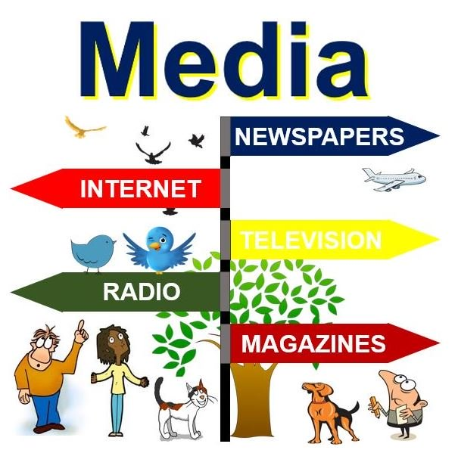
The media
Media present the both positive and negative aspects about health and social issues. It has great influence on contemporary health and social care issues.
The population quickly learn about different things and adopt it by watching on social media. Health issues are now common in various countries and internet has become important source for sharing the information.
People especially young are research on internet and embrace the theories and perceptions related to health.
In developed countries and underdeveloped countries, people have great influence of social media.

Slide 4
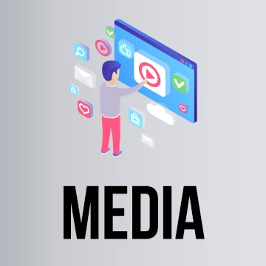
The Media (cont.…)
Demographic data using by media in reports has great influence on human minds and the expert opinions or words change the attitude, thoughts and behaviour of people.
People suffering from health and social care issues rely on radio and newspaper reports.
Young people spend their all-time on face book, twitter and You-tube. Childcare and schools follow the weather report and depend on warning given by professional doctors on changing season.
Health and social care area is changing issues on media and people believe on these reports. Similar way, gynaecologist or midwives gives opinions on TV ads and in magazines (Bates, 2011).

Slide 5
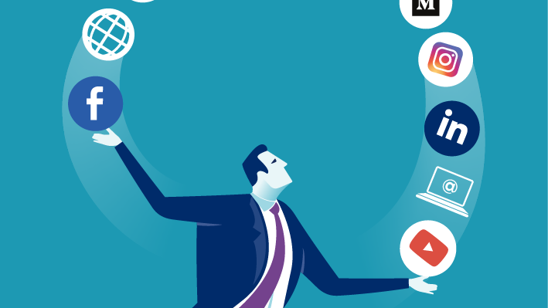
Impact of the COVID-19 pandemic on social media
During a time of social distance and limited contact with others, social media became an important place to interact. Social media platforms are meant to connect people and helped the world remain connected, largely increasing usage during the pandemic. Since many people are asked to remain home, they have turned to social media to maintain their relationships and to access entertainment to pass the time.
The COVID-19 pandemic has affected the usage of social media by the world's general population, celebrities, world leaders, and professionals alike. Social networking services have been used to spread information, and to find humor and distraction from the pandemic via Internet memes.
However, social distancing has forced lifestyle changes for many people, which put a strain on mental health. Many online counselling services that use social media were created and began to rise in popularity, as they could safely connect mental health workers with those who need them.

Slide 6
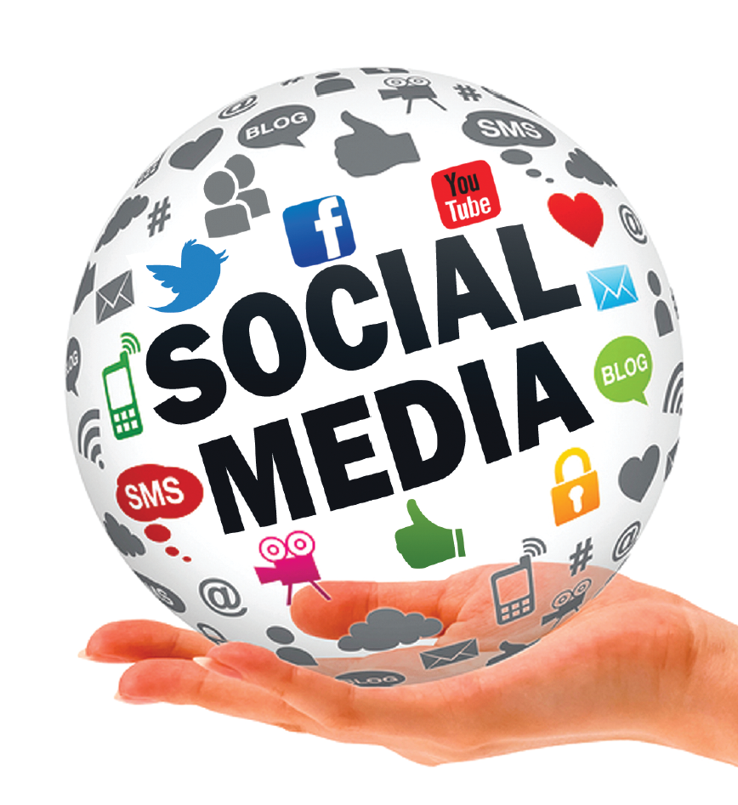
Aim of social media on COVID-19
Investigated public attitudes and perceptions towards COVID-19 on social media,
Information about COVID-19 on social media, use of social media for prediction and detection of COVID-19,
The effects of COVID-19 on mental health, and government responses to COVID-19 on social media.

Slide 7
Aim of social media on COVID-19
The aim of understanding the roles that social media has had since the beginning of the COVID-19 crisis.
We investigated public attitudes and perceptions towards COVID-19 on social media,
information about COVID-19 on social media, use of social media for prediction and detection of COVID-19,
the effects of COVID-19 on mental health, and
government responses to COVID-19 on social media.

Slide 8

COVID-19
Severe acute respiratory syndrome coronavirus 2 (SARS-CoV-2), and the resulting COVID-19, is a substantial international public health issue.
As of Jan 18, 2021, an estimated 95 million people worldwide had been infected with the virus, with about 2 million deaths.¹
As a consequence of the pandemic, social media is becoming the platform of choice for public opinions, perceptions, and attitudes towards various events or public health policies regarding COVID-19.

Slide 9

COVID-19 as an infodemic
In addition to being a global threat, COVID-19 is referred to as an infodemic. The direct access to content through platforms such as Twitter and YouTube leave users susceptible to rumors and questionable information.
This information can strongly influence individual behaviors, limiting group cohesion and therefore the effectiveness of government countermeasures to the virus.
Platforms were additionally used by politicians, political movements, and national and state level health organizations to share information quickly and reach a lot of people.
Medical professionals have also used social media in an effort to educate the general population about the impact of working in PPE for upwards of twelve-hour shifts, utilizing a trend that showcased their faces after their shifts and their masks are removed.
Many of the individuals who participated had bruises, indents, redness and even bandaids covering blisters formed by the masks sitting tight on their faces for hours

Slide 10
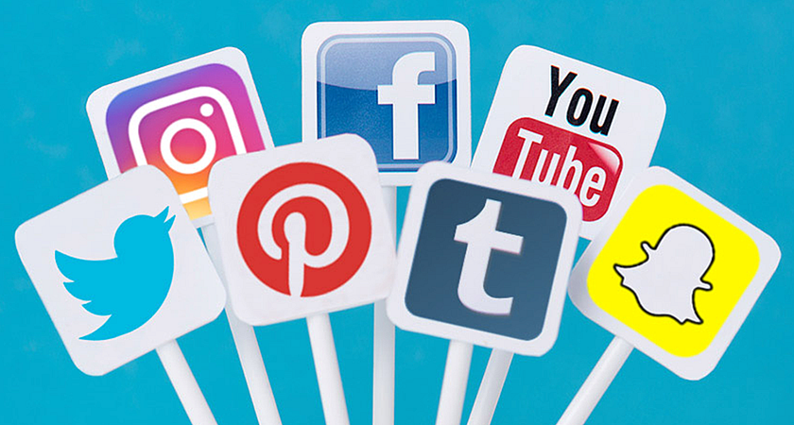
Understanding the roles of social media
Social media has become a pivotal communication tool for governments, organisations, and universities to disseminate crucial information to the public.
Numerous studies have already used social media data to help to identify and detect outbreaks of infectious diseases and to interpret public attitudes, behaviours, and perceptions.
framework, including infodemics, public attitudes, mental health, detection or prediction of COVID-19 cases, government responses to the pandemic, and quality of prevention education videos.
Social media, particularly Twitter, can be used to explore multiple facets of public health research.

Slide 11
Roles of social media
As a consequence of the pandemic, social media is becoming the platform of choice for public opinions, perceptions, and attitudes towards various events or public health policies regarding COVID-19.
Social media has become a pivotal communication tool for governments, organisations, and universities to disseminate crucial information to the public.
Numerous studies have already used social media data to help to identify and detect outbreaks of infectious diseases and to interpret public attitudes, behaviours, and perceptions.
Social media, particularly Twitter, can be used to explore multiple facets of public health research.
Analysing and disseminating information from peer-reviewed, published research can guide policy makers and public health agencies to design interventions for accurate and timely knowledge translation to the general public.

Slide 12
Roles of social media (Cont.…)
Social media can also be effectively used to communicate health information to the general public during a pandemic.
Emerging infectious diseases, such as COVID-19, almost always result in increased usage and consumption of media of all forms by the general public for information.⁸
Therefore, social media has a crucial role in people's perception of disease exposure, resultant decision making, and risk behaviours.

Slide 13
Role of social media (Cont.…)
Social media as an assessment of the public's interest in, and responses to, emerging infectious diseases;
Use of social media in communicating emerging infectious diseases; and evaluation of the accuracy of medical information that is related to emerging infectious diseases on social media.
social media’s data to track and predict outbreaks of emerging infectious diseases.
Government responses that were distributed via social media have been increasingly crucial in combating infodemics and promoting accurate and reliable information for the public.

Slide 14
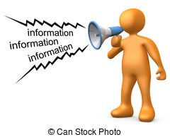
Spreading information
Social media has been used by news outlets, organisations, and the general public to spread both valid information and misinformation about the pandemic. The WHO, medical journals, and health care organisations have been updating and spreading information across numerous platforms with partnerships with Facebook, Google Scholar, TikTok, and Twitter.
Doctors are also joining groups on social media to spread information about treating the disease
Others such as an attending emergency medicine physician in hospital system have been using their social media accounts to report first hand accounts of working to combat COVID-19

Slide 15
Spreading information
Endorsements and up-to-date information will be available through posts on the top of Facebook's News Feed for guidance that is presented by the World Health Organization.
An educational pop-up with credible information will appear when using the search function on Facebook, or through a related hashtag on Instagram that is based on data from global health organizations and local health authorities.
For COVID-19, accurate and reliable information through social media platforms can have a crucial role in tackling infodemics, misinformation, and rumours.

Slide 16
Fighting an Infodemic
COVID-19 has increased the World Health Organizations (WHO) usage of social media as well. The platform WHO Information Network for Epidemics was created after COVID-19 was declared a Public Health Emergency.
The 20 person staff work to provide evidence-based answers to combat rumors found across platforms and ensure any “coronavirus” search across social media platforms, as well as Google, directs them to the WHO website or Center for Disease Control providing reliable information.
On 18 January 2021, the UK Parliament, in the presence of the Public Administration and Constitutional Affairs Committee, held a session to combat misinformation regarding the COVID-19 pandemic on social networking and Internet media platforms.
The session had a panel of behavioural science experts and another of media representatives of major organizations including, Facebook, Sky News, and Reuters.

Slide 17
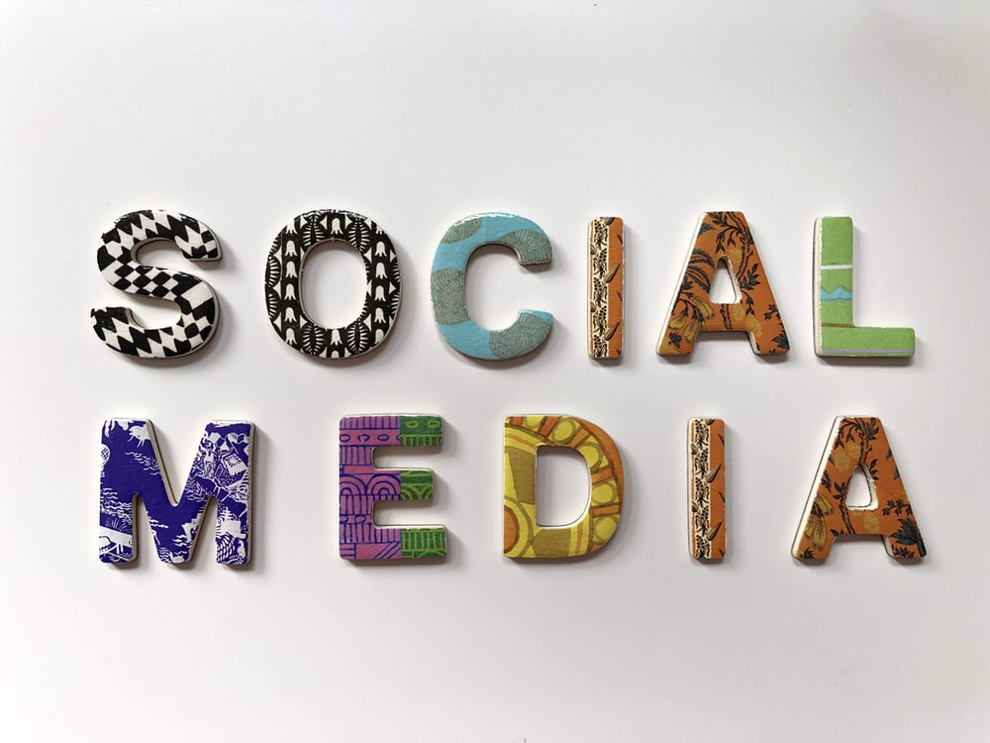

Social media and COVID-19
Emerging infectious diseases, such as COVID-19, almost always result in increased usage and consumption of media of all forms by the general public for information.
Therefore, social media has a crucial role in people's perception of disease exposure, resultant decision making, and risk behaviours.
As information on social media is generated by users, such information can be subjective or inaccurate, and frequently includes misinformation and conspiracy theories.
Hence, it is imperative that accurate and timely information is disseminated to the general public about emerging threats, such as SARS-CoV-2

Slide 18

Social media as contagion and vector
According to World Health Organisation (WHO), the term infodemic is a combination of information and epidemic. This refers to a fast and widespread dissemination of both accurate and inaccurate information about an epidemic, such as COVID-19.
Analysing and disseminating information from peer-reviewed, published research can guide policy makers and public health agencies to design interventions for accurate and timely knowledge translation to the general public.

Slide 19
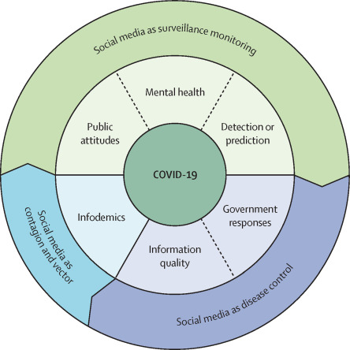

Slide 20

Reference Tsao, S.F., Chen, H., Tisseverasinghe, T., Yang, Y., Li, L. and Butt, Z.A., 2021. What social media told about us in the time of COVID-19: a scoping review. arXiv preprint arXiv:2101.01688. DOI:https://doi.org/10.1016/S2589-7500(20)30315-0 Smith, A., 2021. Facebook and Instagram to Limit Coronavirus Misinformation. [online] Entrepreneur. Available at: <https://www.entrepreneur.com/article/345770> [Accessed 7 March 2021]. Llewellyn, S., 2020. Covid-19: how to be careful with trust and expertise on social media. BMJ, 368. Zarocostas, J., 2020. How to fight an infodemic. The lancet, 395(10225), p.676. BBC News. 2021. Coronavirus: Fake news is spreading fast. [online] Available at: <https://www.bbc.co.uk/news/technology-51646309> [Accessed 7 March 2021].

